Slide 1
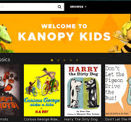
Rockbuster Stealth, LLC Launch Strategy
Online Video Services
By: Angela Hamilton

Slide 2

Introduction
Rockbuster Stealth, LLC is a movie rental company that used to have stores around the world. Facing stiff competition from streaming services such as Netflix and Amazon Prime. The Rockbuster Stealth management team is planning to use its existing movie licenses to launch an online video rental service in order to stay competitive. This presentation will provide information to help with the launch strategy for the new online video service.

Slide 3

Key Questions and Objectives
Which movies contributed the most/least to revenue gain?
What was the average rental duration for all videos?
Which countries are Rockbuster customers based in?
Where are customers with a high lifetime value based?
Do sales figures vary between geographic regions?

Slide 4
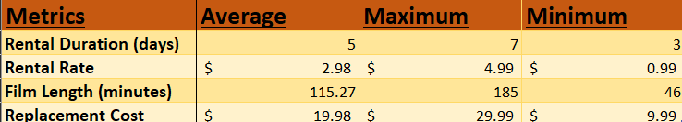
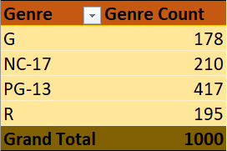
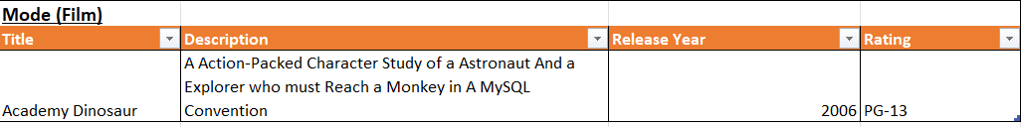
Rockbuster Data Overview
Film Rental Information
Genre Ratings and Count

Slide 5

01
Which movies contributed the most/least to revenue gain?

Slide 6
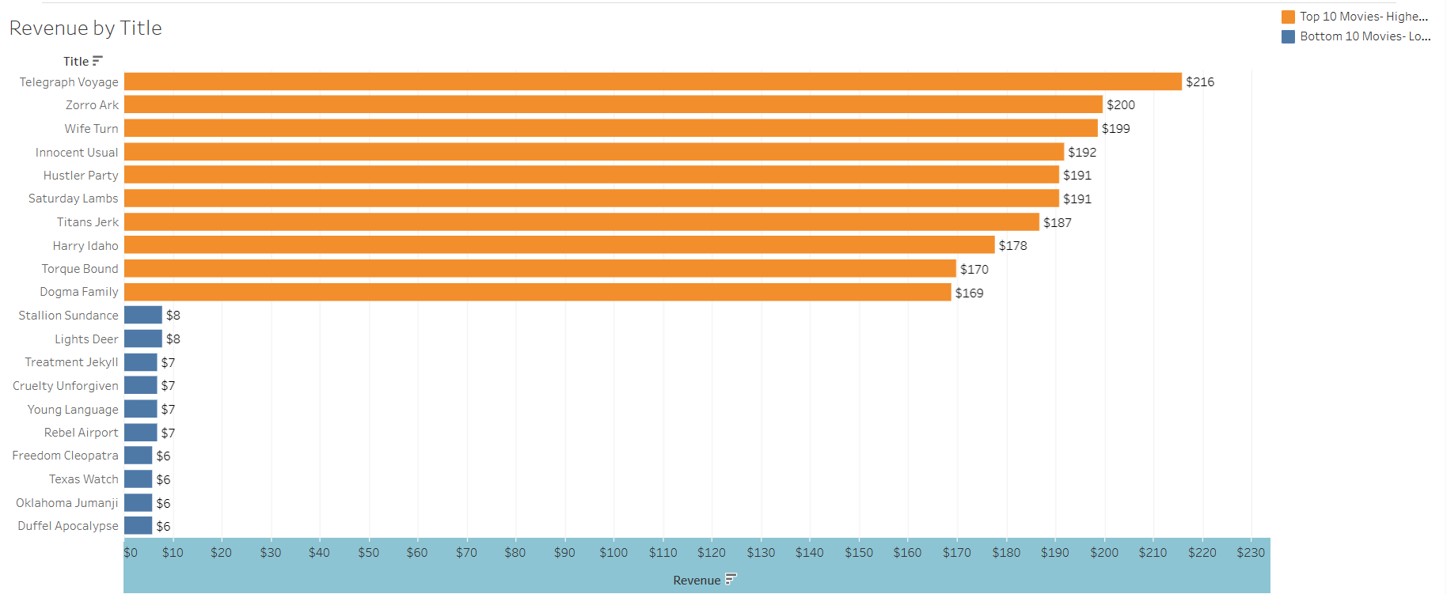
The top three revenue-earning Movie Titles are Telegraph Voyage, Zorro Ark, and Wife Turn.
The bottom three revenue-earning Movie Titles are Duffel Apocalypse, Oklahoma Jumanji, and Texas Watch.

Slide 7
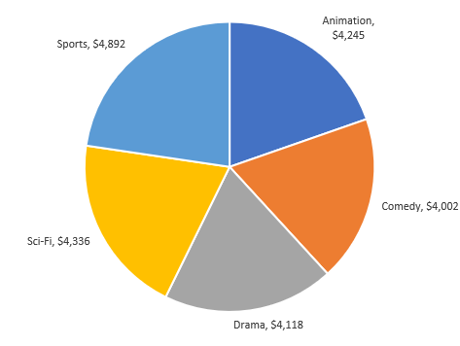
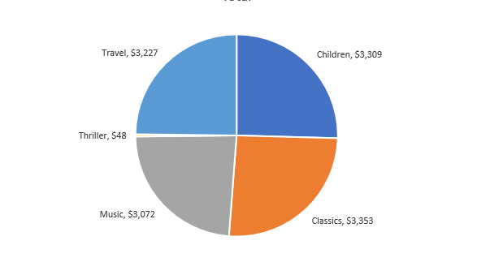
Revenue Gain Contribution (Most/Least)
Top 5 Genres
Bottom 5 Genres
Sports, Sci-Fi and Animation are the highest revenue earning genres.
Thriller, Music and Travel are the lowest revenue earning genres.

Slide 8
02
What was the average rental duration for all videos?

Slide 9
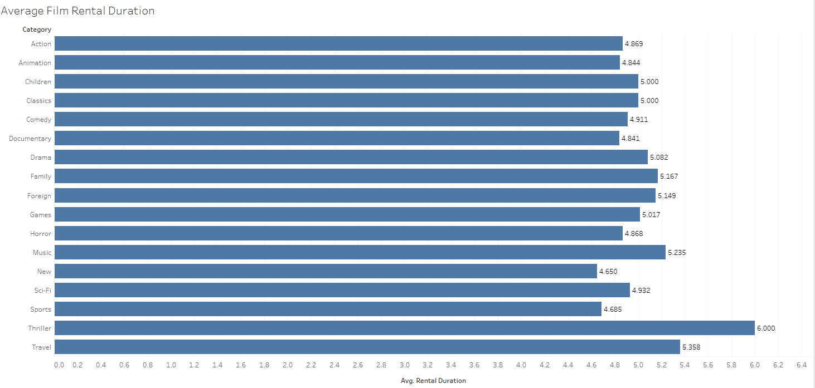
Film Rental Information
Average Rental Duration for Videos is 5 days.
Observation: Thriller movies have the longest average rental duration.

Slide 10
03
Which countries are Rockbuster Customers based in?

Slide 11
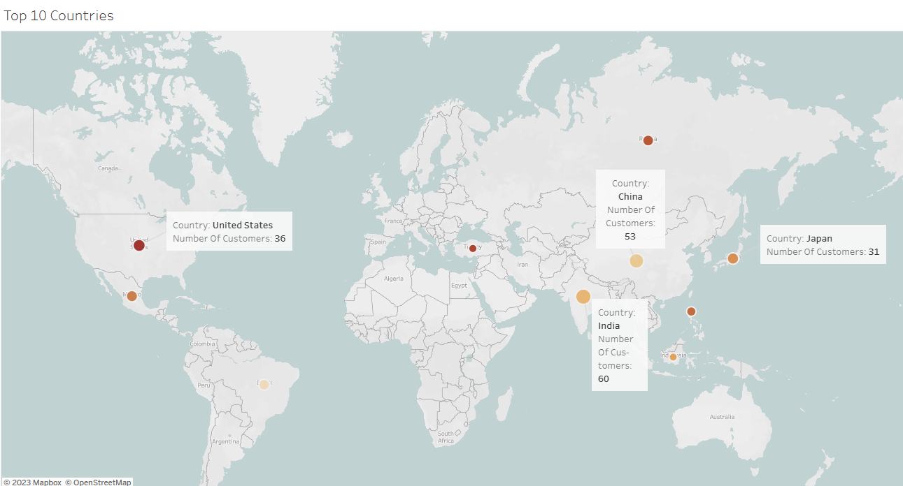
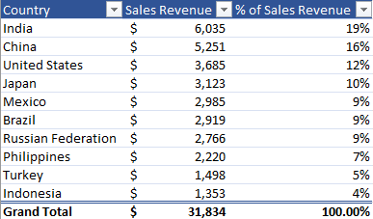
Rockbuster Customer Base
The Countries with the most customers are India, China, and the United States. These three countries make up approximately 47% of total sales revenue.
India has the most customers, which comprises approximately 19 % of total sales revenue.

Slide 12
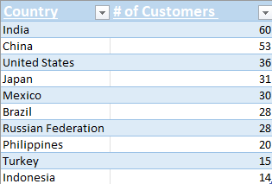
Top 10 Countries with Number of Customers

Slide 13
04
Where are customers with a high lifetime value base?

Slide 14
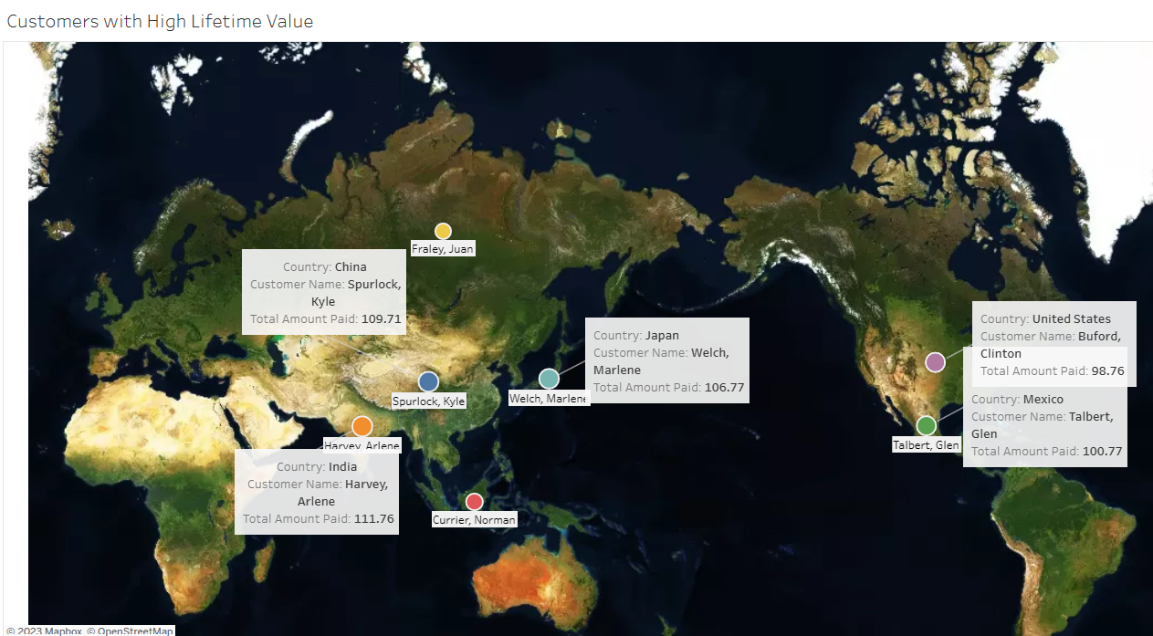
High Lifetime Value Customers
Customer Base:
India- (highest customer base)
China
Japan
Mexico
United States

Slide 15
05
Does sales figures vary between geographic regions?

Slide 16
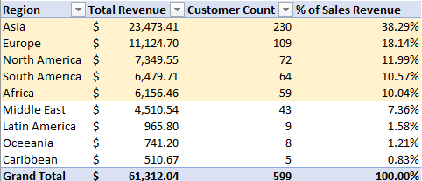
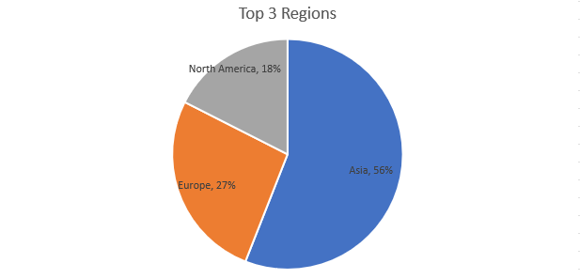
Comparing Sales Revenue by Region
Regions with the highest customer counts also have higher sales revenue.
The top 3 Regions are Asia, Europe, and North America. Asia is our highest performer, producing 56% of total sales revenue.

Slide 17

Recommendations
Continue to target the Regions with the highest customer base and Revenue.
Increase Rockbuster’s movie catalog and content with new titles being available frequently.
Share content on social media that is interesting to our targeted audience to assist with identifying algorithms that show what current and potential customers like and dislike for future forecasting.
Build more awareness around the company in the Caribbean, Latin America, and Oceania to attract and intrigue our target audience. I recommend offering discounts and promotional packages in these regions, as they bring in less Revenue.
Offer a downloadable app on mobile devices to boost sales.
Add content in different languages.

Slide 18

Thank you
Angela Hamilton

